Slide 1
Modern Tech Stack – the key to success in a data engineering career
By AakanshA

Slide 2
Overview
We will be going through, what tech stack is, the most common ones, then introduction to my project and it will end with a quick demo

Slide 3
Popular Tech Stake
Language and version control
Git/GitHub
SQL used to extract model and analyze data
Python: dominant for pipeline building
Data Processing Frameworkds
Apache Spark
Dbt
Storage and Warehousing
Cloud Platforms: AWS, Google Cloud Platform and Microsoft Azure
Cloud Data Warehouses: Snowflake, Amazon Redshift

Slide 4
What benefit will this provide for you?
Better Career Opportunities
High demand for cloud and data skills
Snowflake and dbt appear regularly in data engineering roles
2. Future Ready Skills
Data powers analytics and AI
Cloud and data platforms continue to grow
Skills remain relevant and evolve as technology evolves
3. Real business Impact
Transform raw data into useful insights
Improve decision-making
Solve real business problems

Slide 5
The project
The goal of this project was to transform raw Airbnb booking, listing and host data into reliable, analytics-ready information that can be used to generate business insights and support data-driven decision-making.
Why does Airbnb data matter?
It enables the organisation to understand
  Revenue performance – cities, properties, listings that generate most revenue
  Customer demands trends – which property and room type is most popular
  Host performance – which hosts have the highest response rate
  Areas for business improvement – identify trends that can help improve pricing

Slide 6
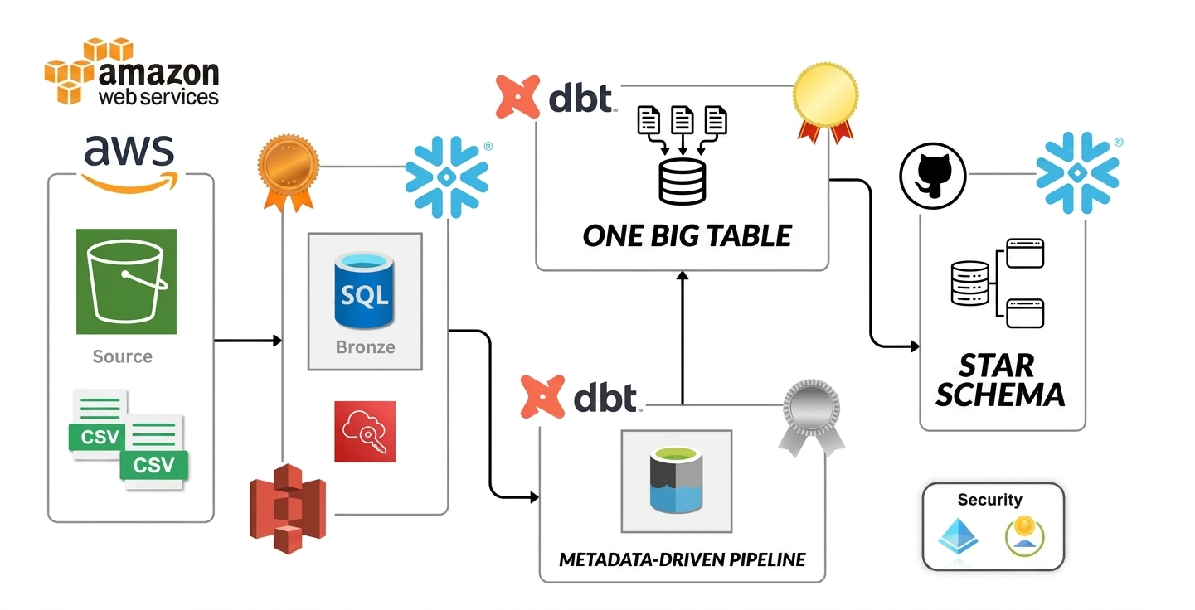
Notes:
"Before diving into the technologies, I want to give a quick overview of the end-to-end solution. Raw CSV data is stored in AWS S3 and loaded into Snowflake, where it is stored in the Bronze layer. dbt is then used to transform the data through a metadata-driven pipeline, producing a One Big Table and a Star Schema for analytics and reporting. GitHub is used for version control to manage changes throughout the project. Together, these tools form a modern data stack that automates data processing and creates analytics-ready datasets."

Slide 7
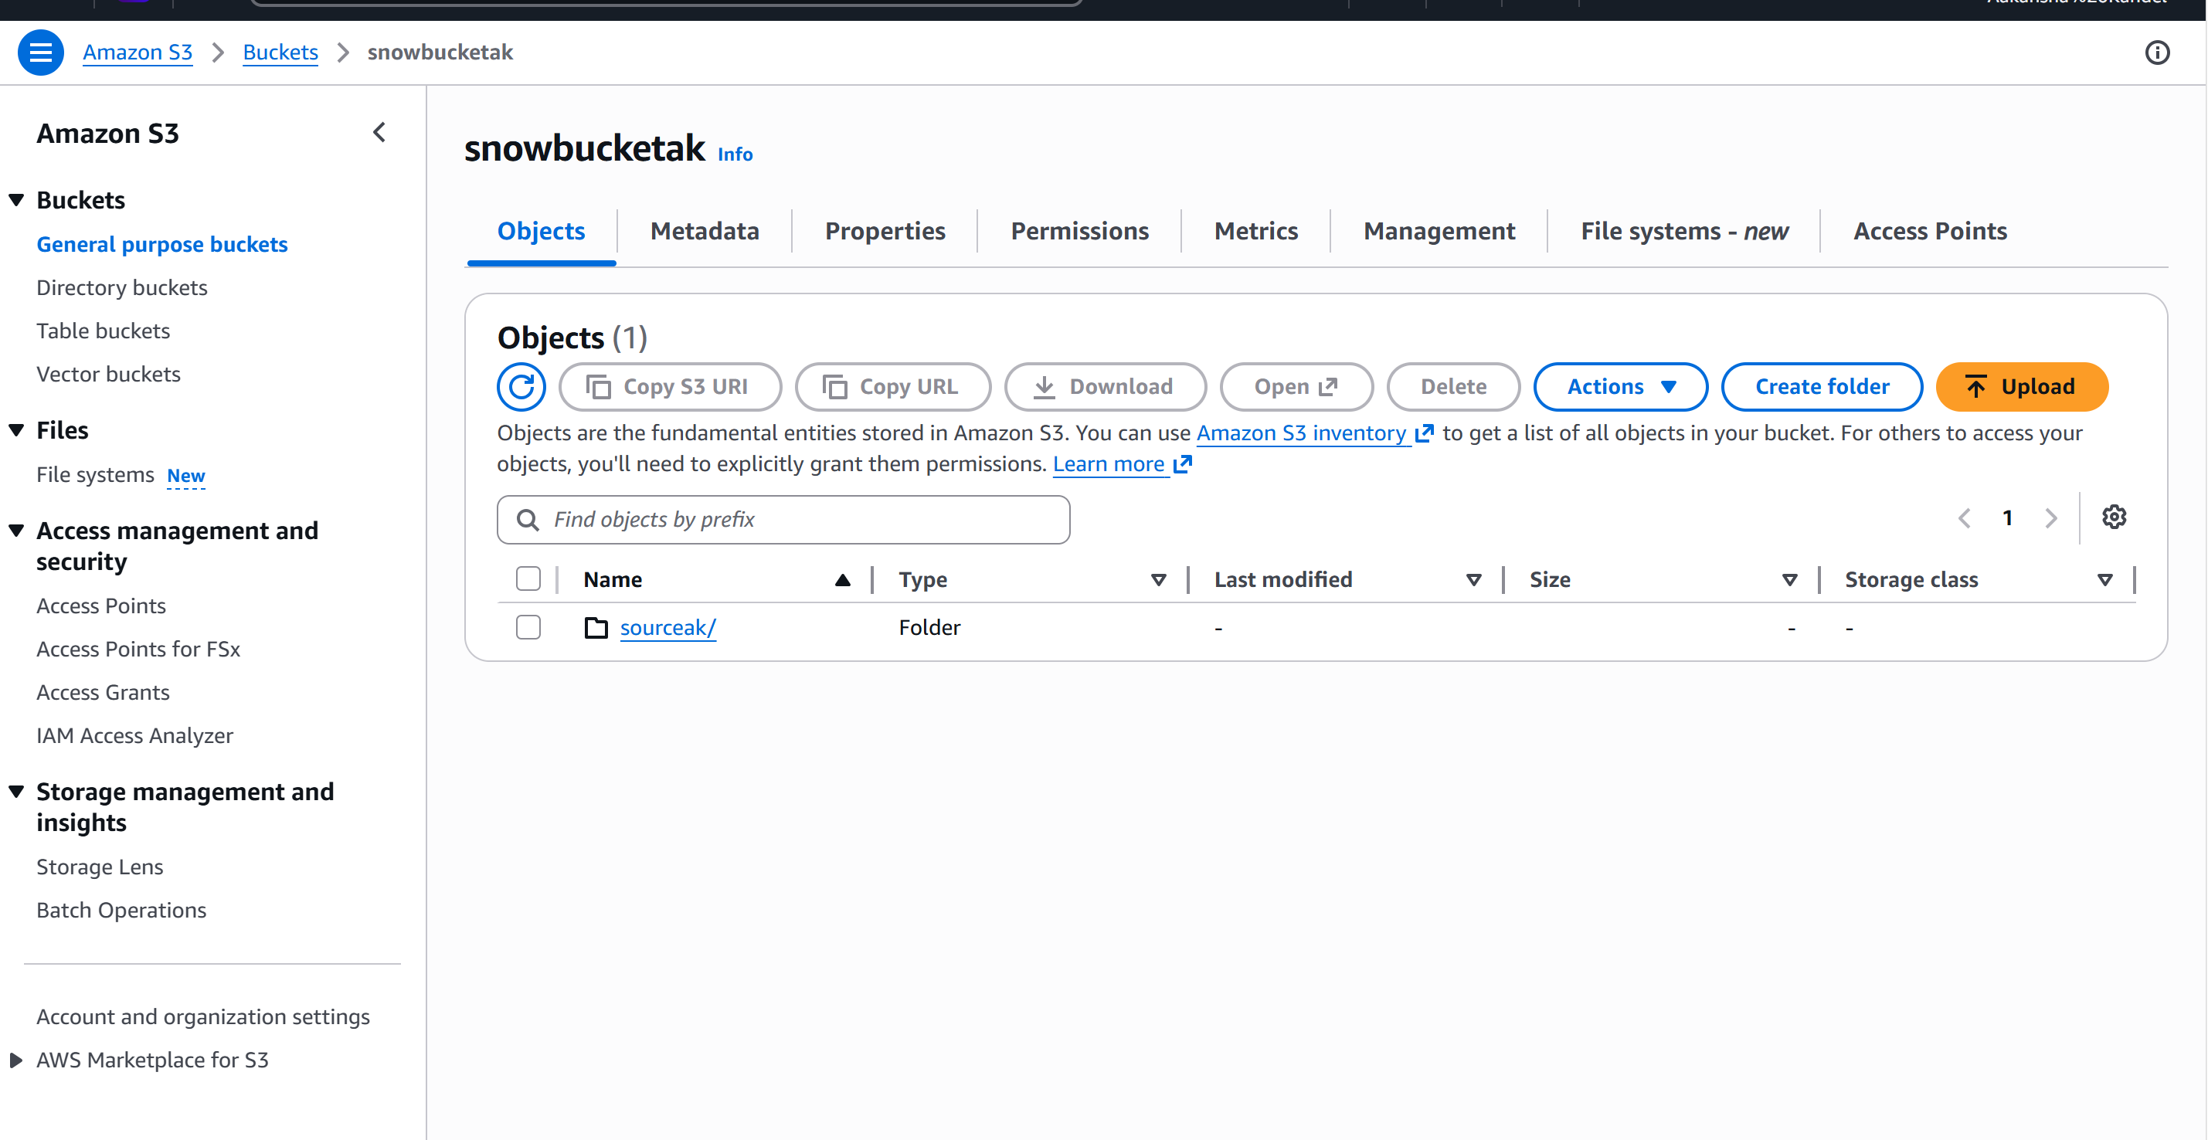
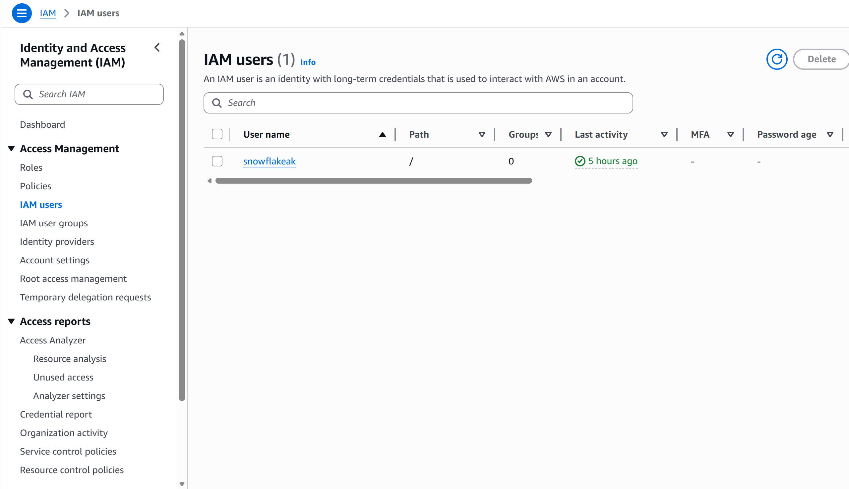
AWS
Screen shot – mainly talk about IAM

Slide 8
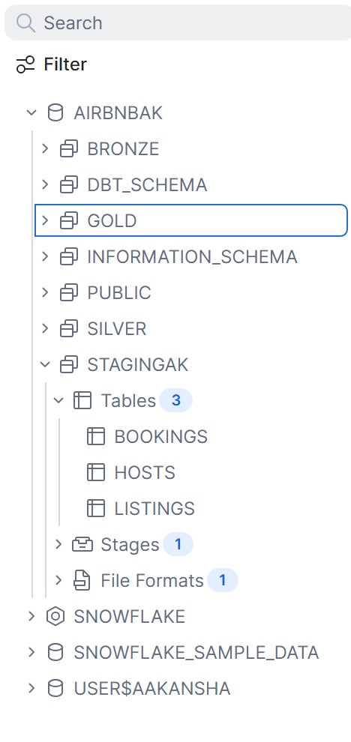
Snowflake Screenshot of database
DDL + Copy Data
During Copy Data:- aws-key-id and aws secret-key will be required to copy data from AWS S3 data lake to this snowflake staging

Slide 9
Dbt
What is Git used for???
The initial Git commands
Creating user
Macros
And the model strucute
(briefly explain these all)

Slide 10
Git and dbt
"I initialized the project in Git, committed the initial version of the code, and then created a separate feature branch for development. This follows standard version-control practices where changes can be developed independently before being merged into the main branch.“
Git branch –m main
git add .
Git commit –m “initial commit”
Git switch –c feature Aakansha
Git branch
This is something that comes with practice
I have put it here just to let you know how configuration works, but git commit is the one that creates the basic structure for models

Slide 11
Time for the demo using dbt
- you are going to have everything cleared out before presentation, so dbt loads everything
-you are going to show because it’s incremental load 0 rows are going to be added
-change something in the staging data and show then how new updates are added
-at the end briefly mention testing – go over the video for it.

Slide 12
I really hope that you all liked it, I recommend you all to do this guided project as a practice, and then try to build it yourself later.

